Slide 1
Nanotechnology

Slide 2


Slide 3
From the Syllabus
Nanomaterials are substances that contain particles in the size range 1–100 nm. Matter at the nanoscale can be manipulated to create new materials, composites and devices; the different characteristics of nanomaterials can be used to provide commercially available products. As products are designed on the basis of properties which are different from the bulk material, their use can be associated with potential risks to health, safety and the environment and this has led to regulations being developed to address new and existing nanoform materials.

Slide 4
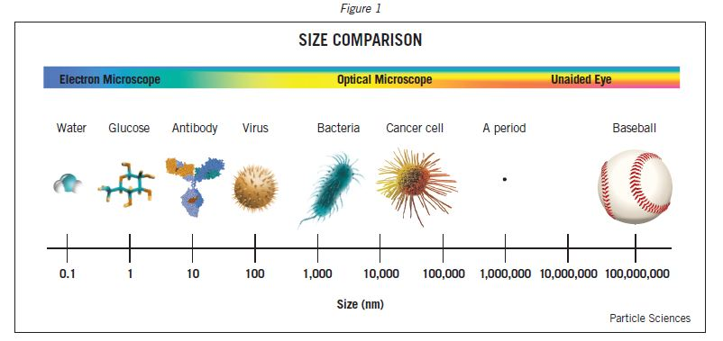
Nanoscale
Nanoparticles are between 1 and 100 nm in size.

Slide 5
Conversions
1nm = 10⁻⁹ m
How many nanometers are there in each of the following?
1.0m = ...... 10⁹ nm
1.0 mm = .... 10⁶ nm
1.0 µm = .... 1000 nm

Slide 6
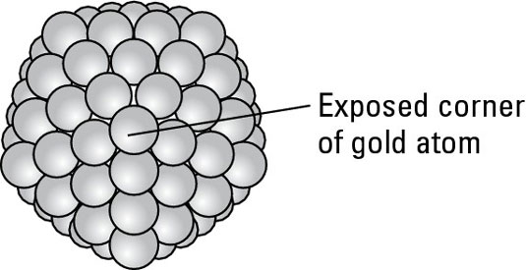
Why are nanoparticles different?
Nanoparticles have different properties to their bulk material because of their large surface area to volume ratio.
In the bulk form, each gold atom is surrounded by twelve other gold atoms (except those at the surface); even the gold atoms at the surface have six adjacent gold atoms.
In a gold nanoparticle a much larger percentage of gold atoms sit at the surface.

Slide 7
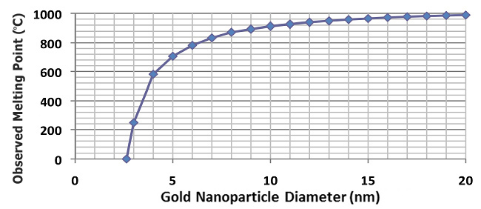
Nanoparticle properties differ from the properties of bulk materials
Gold normally melts at 1064°C but...

Slide 8
Nanoparticle properties differ from the properties of bulk materials
In bulk form, gold reflects light.
At the nanoscale, some wavelengths of light are absorbed.
A nanoparticle of about 90 nm in size will absorb colors on the red and yellow end of the color spectrum, making the nanoparticle appear blue-green. A particle about 30 nm in size, absorbs blues and greens, resulting in a red appearance.

Slide 9
Nano Applications
Sunscreens
Surface coatings
Drug delivery
Composite materials (lighter & stronger)

Slide 10
Safety Issues?
Nanoscale ingredients are regulated but the risks of using nanoscale materials is not fully understood.

